Slide 1

http://www.3mgorseinonrr.co.uk/

Slide 2
We are a running family not just a running club.
Club started in 1989
by employees from 3Ms factory
145 Members
Training:
  Summer – locations around Swansea Winter – Swansea University track,
12 Coaches
  5 CIRF
  7 LIRF

Slide 3
Membership

Slide 4
2020 COVID-19 Pandemic
Gave us many challenges
Lock down challenges.
How did we?
Engage and motivate members
Keep in contact
Support everyone
Return to training challenges-
How did we ?
Keep everyone safe.
Organise groups and venues with numbers restricted.

Slide 5
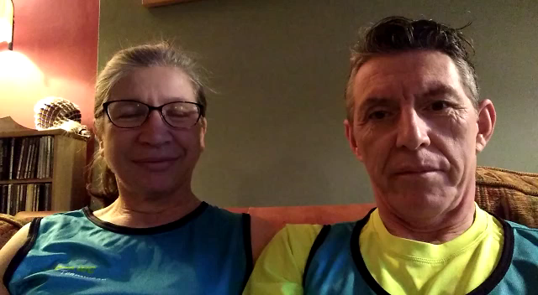
What our members say

Slide 6
Lockdown Challenges
How did we motivate and keep in contact with members?
Virtual training sessions
Weekly coaches' corner
Paul’s Strength and conditioning circuits
Virtual challenges
Social events

Slide 7
Weekly
Virtual training sessions
Emailed every Monday Same day pre COVID-19
Inclusive -suitable for any environment and all abilities
Different theme -method of training every week
Several monthly challenges.
Set by a different coach weekly
  Kept the coaches engaged and involved in the club (some unable to run due to injury / shielding)
Members shared comments/pictures of their sessions on social media.
Member commented that the sessions helped give routine.

Slide 8
Example of a virtual session
Session Title - Tempo with a Twist
The purpose of "Tempo Sessions" is to increase the running speed at which lactate builds up - that burning sensation which forces you to slow down. We are able to RUN at a speed for so long until lactate kicks in, but by doing regular TEMPO work you can increase that speed at which that happens.
Warm Up
Start with some dynamic stretches such as Squats / Lunges / Heel Flicks / High knees etc.
10mins easy jog
Main Set
Run for 40mins at your half-marathon pace (if you don`t have a half-marathon time to base this off, add 15-20secs per mile to your current 10k pace).
Here`s the Twist : Every fifth minute throw in a 30 second "Burst" at 5k -10k effort followed by an immediate return to half-marathon pace.
Warm Down
10mins easy jog followed by some static stretches.
Please ensure you follow the latest Welsh Government COVID-19 guidance:
  Do not travel to run
  Run on your own or with your own household
  Keep 2 metres distance between yourself and anyone you meet or run with.
  Be aware of your surroundings paying particular attention to walkers, dog walkers, other runners and children.

Slide 9
Coaches Corner
Articles written by the coaches providing tips for training, injury.
Different coach every week
Saved on club web site for future reference.
Topics include-
Have You Lost That Loving Feeling- how to fall in love with running again when you have lost your mojo
Why Rest and Recovery important
Planning an individual training schedule
Relaxed running and Apple Cake

Slide 10
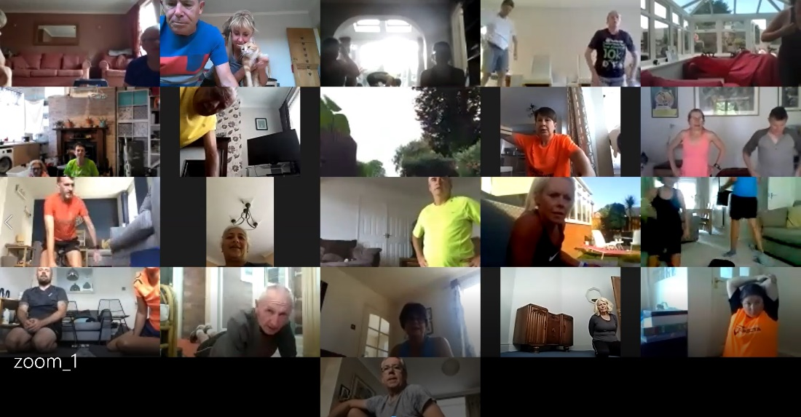
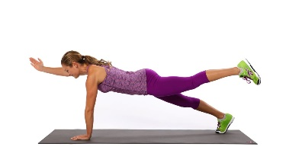
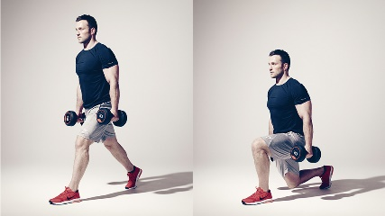
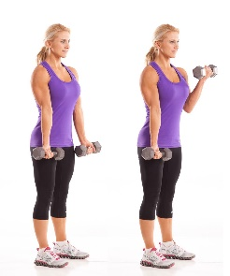
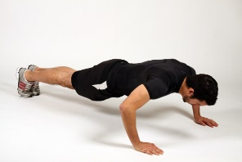
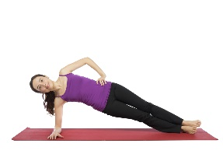
Paul’s Zoom circuits
Strength and conditioning for runners every Monday and Thursday
20 -30 joined in every session

Slide 11
Why did everyone enjoy circuits ?
Mental, social and physical benefits.
Excellently organised by Paul one of our CIRF coaches who also a qualified personal trainer. Exercises demonstrated by Linda (his wife)
Social and fun
  seeing our running family and their families in garden, living rooms,
  Seeing people were using for weights- Beer/cider cans!
Routine - Something to look forward to
Runners have seen physical improvement
Inclusive for everyone
Exercises have changed -keep up motivation

Slide 12
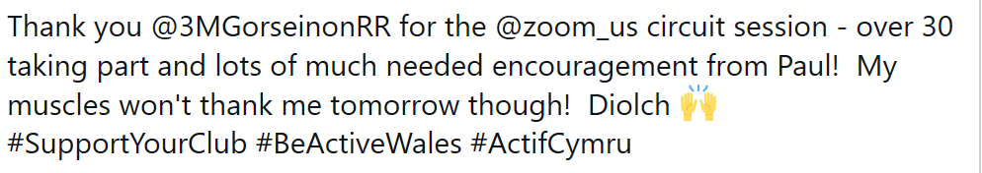
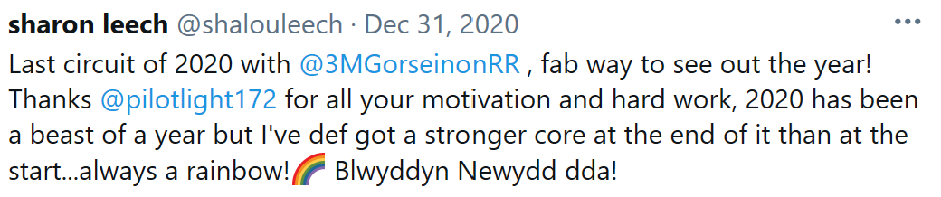


Slide 13
Virtual Monthly challenges March-June
Members submitted times via Microsoft Forms online -
with a link to their Strava / Garmin activity or a screenshot of their run.

Slide 14
Keeping in Contact
Weekly Emails:
  Virtual session details
  Circuit session details
  Updated COVID-19 guidance
Facebook
  Public page
  Private members only group
Strava
  Group for members only
Welfare
  Emails, text, phone calls. Zoom circuits

Slide 15
Keeping in contact Welfare
We are a running family, and we know our members and we look out for one and other.
Since March 2020 our two Welfare Officers have been proactive keeping in touch with members :-
Who are shielding or vulnerable.
People affected by COVID-19
Or those we simply hadn’t heard from or seen “active” on social media sites or missed training when it was back.
We used Email/Messenger/ text to contact members.

Slide 16
COVID 19 updates
Constant update emails/social media sites of the government current regulations regarding exercising outdoors.
Action taken if we thought someone was in breach of these regs.

Slide 17
June - ‘Back to training’-Challenge
How did we prepare for new training regulations to ensure members were safe ?
Coaches and committee members attended WA webinars
Regular zoom committee meetings
Coaches zoom meetings
Keep updated on COVID regulations
Researched on-line payment, registration platforms
Researched and risk assessed possible training venues.
Planned/organised training groups

Slide 18
Can’t all train together
How we adapted and kept our members safe
How did we organise training groups as only allowed 30 and have over 120 members?
4 groups trained in separate venues
‘BUBBLED’ 28 in a group –allow for 2 coaches
  Members confirmed attendance.
  Registers taken
Easy to track and trace
Members only mixed with the same people
Little movement of coaches between groups
Put friendship groups together
Range of abilities-requested by members
Members felt more confident coming out of lockdown not seeing many people.
Sent out in detail the format of sessions and new regulations.
Everybody missed the contact with all the other club members but said they felt safe.

Slide 19
Venues:
Where did we train?
Venues changed weekly but within same geographical area.
Choose venues with a lots of space, quiet and away from general public.
Safe locations –good surface less likelihood accidents or injury.
Near to car parks
Members assigned into groups geographically - less travelling
No two groups trained in the same venue

Slide 20
Motivation - Time trials
We organised 2 time trial races
Members raced in their -training groups –Bubbles
Times were compared across everyone who raced.
September- Llanelli 5k on Coastal path
December - 3k on the University Track

Slide 21
Members Paying for training
We were a cash / cheque-based club
  Members paid weekly subs at the session
  Members paid for annual membership at club sessions or posting to membership secretary
To avoid use of cash, we moved initially to FullOnSport, then Eventbrite
  Members could now pay online for annual membership
  After consultation with members, weekly subs paid for in 5 weekly blocks
  Members booked the sessions they were able to attend.

Slide 22
We keep accurate online registers available to all on the Committee
Online registers in shared secure area on Microsoft OneDrive for access by all the Committee
Updated straight after training
For monitoring - welfare
Important for track and trace

Slide 23
Winter Training challenge
How do we accommodate 120 members 3 hours track time keeping 28 to a group?
Members choose a time slot for training - used on- line platform
Coaches meet to organise groups
Keep same mixed ability groups every week as ‘Bubbles’
Coaches only crossed groups.
Rota organised one off track group every week.
Members informed club if unable to attend
Registers kept up to date.

Slide 24
Winter Training Rota –Example
Groups | 11th Nov | 18th Nov | 25th Nov | Dec 2nd - 5K GP
 | Track 5pm | Track5pm | Track 5PM | 5pm
Group A | Dewi/Mark | Paul/Linda | Ian B/ Alyson | Dewi/Alyson
 | Track 6 pm | Track6:00 PM | Off track Ashley Rd 6.30pm | 5.45
Group B | Dewi/Mike | Paul/Linda | Alan/Steve | Dewi/Alyson
 | Track 7pm | Off track Ashley Rd 6.30pm | Track 6:00 PM | 6.30pm
Group C | Dewi/Mike | Ross/Alyson | Ian B/Dewi | Paul/Linda
 | Off track 6.30 pm | Track 7pm | Track7pm | 7.15pm
Group D | Alyson/Gareth | Paul/Linda | Ian B/Dewi | Paul/Linda

Slide 25
Where to add New members?
We had 12 New members from March 2020
When groups capped 30 =28 + 2 coaches
Added new members as reserves to groups some had 5 reserves
Members emailed by Sunday
  If not attending training
  Injured for several weeks
Reserves informed by Monday – every week everyone who wanted to train was able to.
It did need someone to co-ordinate update registers and inform the reserves.

Slide 26
Further Lockdowns and members shielding
Every week from March 2020 we have continued to circulate virtual sessions
This has helped members unable to attend training due to shielding and further local and national lockdowns.

Slide 27
Looking after/treating our members
Pre COVID, we used club funds to subsidise events which include
Bus to Cardiff Half
John Collins Cross country
Annual presentation evening
Monthly buffet
Occasional social drink/ice cream
2021 we are using club funds to pay
for every members’
Welsh Athletics and Club affiliation

Slide 28
What our members have said.
“It’s just lovely being back at training. Thank you and all the coaches for all your hard work organising us all into groups”
"I've really enjoyed the training for the last fortnight. "
Many Thanks
New member Oct 2020
“I’ve been meaning to email to say thank you -I absolutely loved it. I really can’t wait for the next one! Thank you so much!!! Everyone was so friendly and encouraging too. Absolutely lovely lot :-) ”
“Nice Coaches Corner article
There's some good stuff been written so far. “

Slide 29
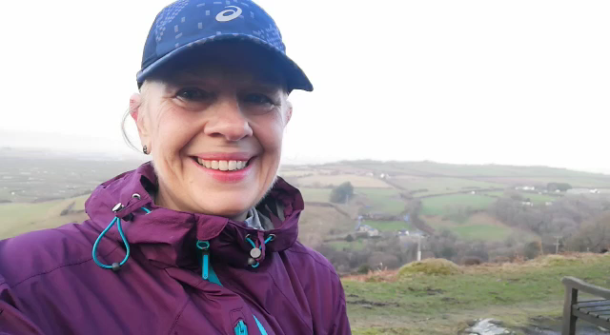
And finally, a video from Karen, one our members who has been following us virtually since March 2020.

Slide 30
What have we learnt over the last year?
We are definitely a running family
Our running club provides a mental and social benefit our members.
What changes will we keep post Covid ?
Payments – Continue -online
Training sessions-Think about
  Size of groups
  Offer more than one training session- different times.
  Keep mixed ability groups

